Slide 1
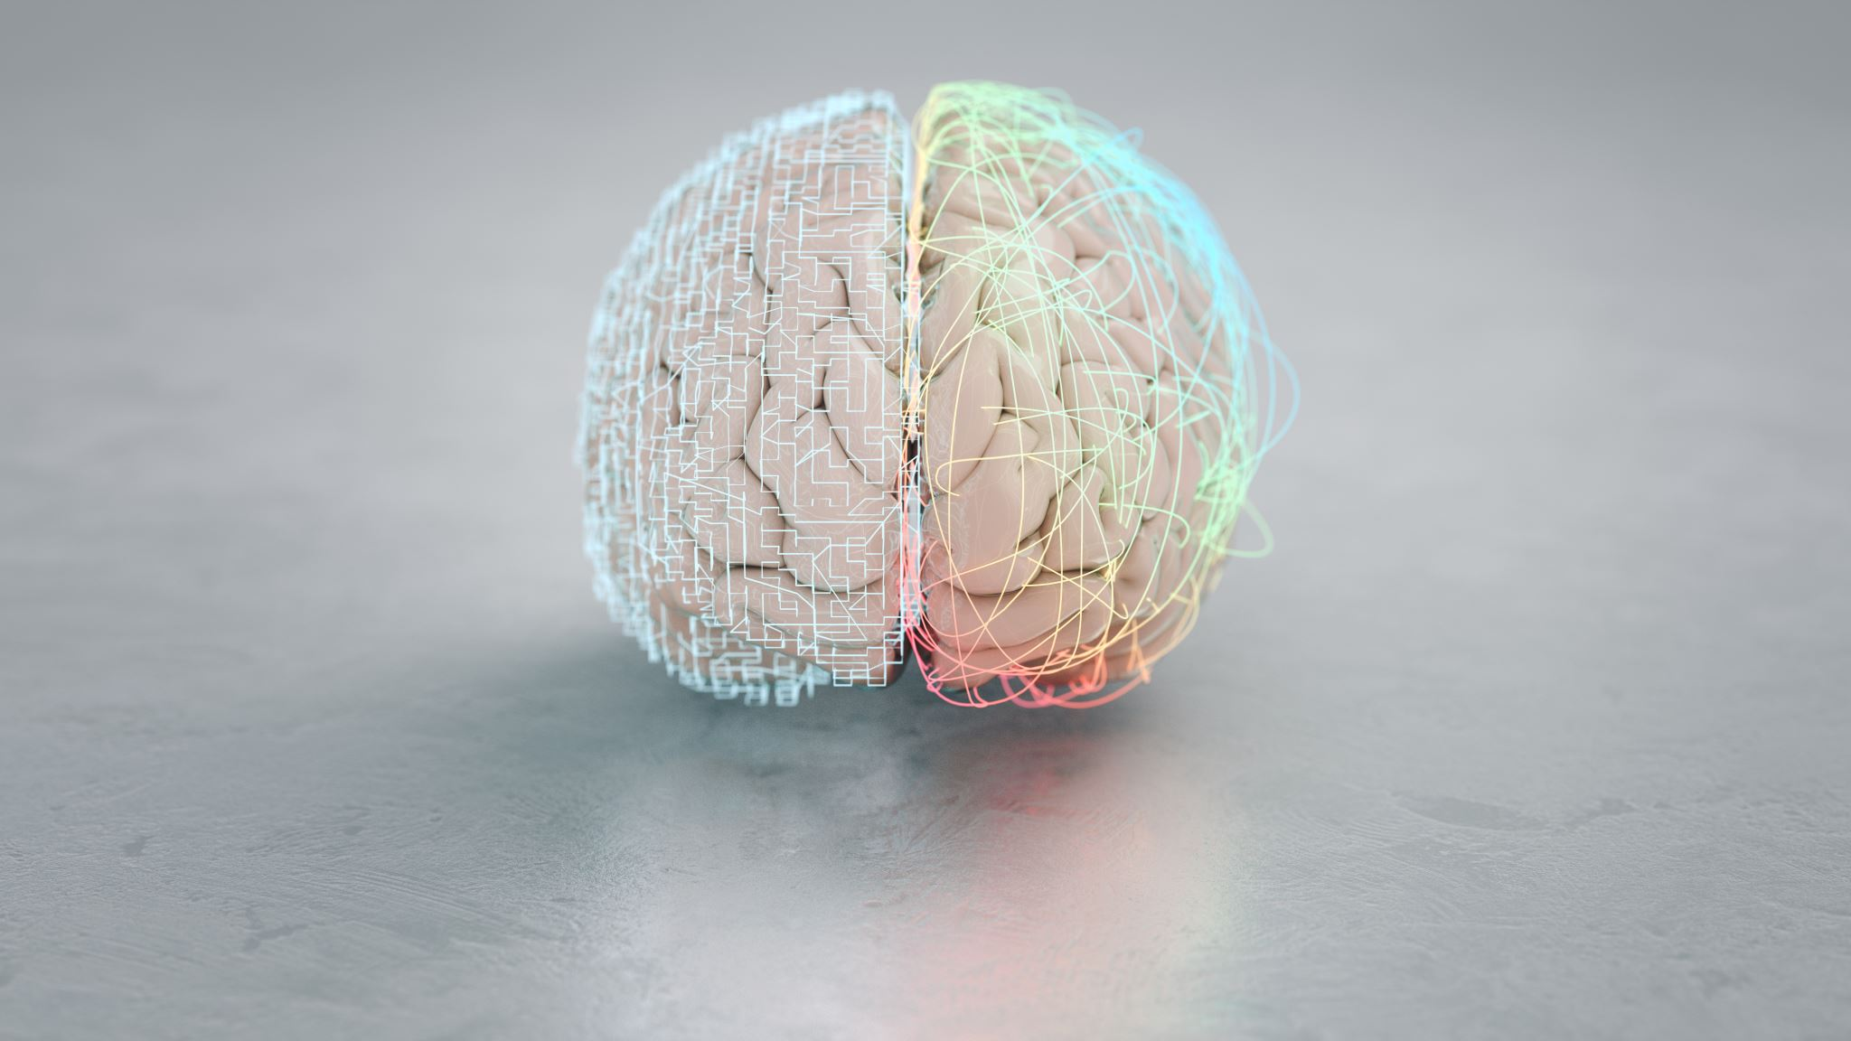
Emotional analysis & explainable AI in Arabic dataset
Alaa Mahmoud Mohamed
Mirna Maher Mahmoud
Karim Anani
Mahmoud ALAa

Slide 2

Objectives
We are going to present :
extend needs on previous work.
Present the contribution of this work.
Suggest future extension on this work .
Main goal :Use explainable ai to understand performance on datasets using different ML, and DL models on Arabic datasets

Slide 3

Contents
PREPROCESSING
FEATURE EXTRACTION
CLASSIFICATION STEP
PRESENTATION OF RESULT
LIME EXPLAINATION

Slide 4
Introduction
Emotion analysis is the process of identifying and interpreting the underlying emotions expressed in textual data. Emotion analytics uses text data from a variety of sources to analyze it and understand the emotions that underpin it.
Fear, happiness, sadness, love, inspiration, or neutrality are all examples of emotions that can be detected and classified in a text
Many researchers have improved a lot in English text , so the Arabic text needs to be improvements

Slide 5
Introduction
Using different models to predict the emotion of the text is very effective in the decision-making process but it is not reliable enough
So they need to be explained in order to understand and trust the model’s decisions.
This is where explainable Artificial Intelligence (XAI) takes the stage.

Slide 6
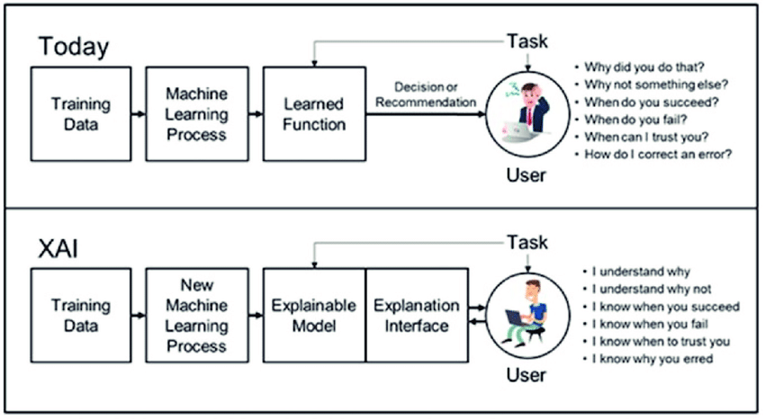
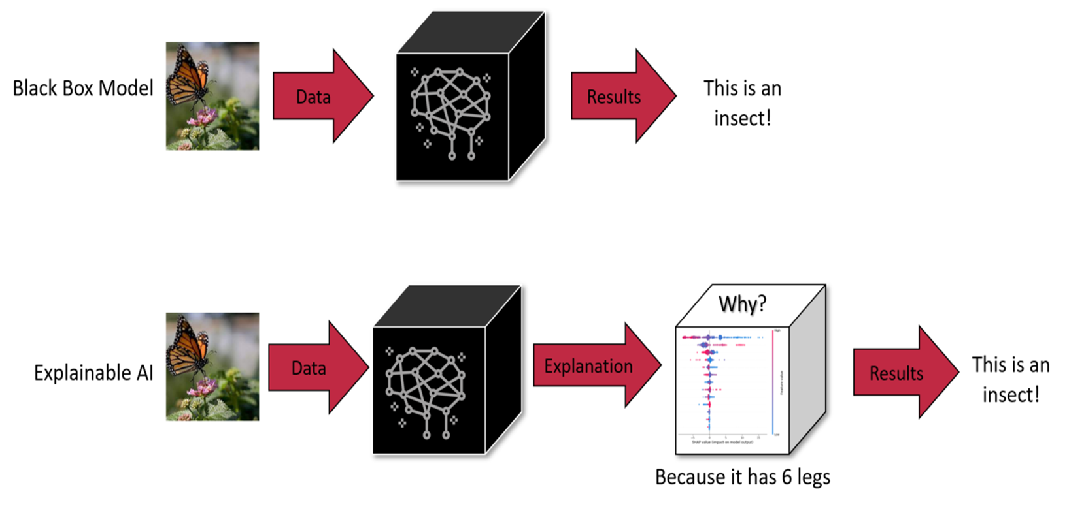
What is XAI

Slide 7
The pipeline for Arabic emotion analysis
DATASET
PREPROCESSING
FEATURE EXTRACTION
EMOTION CLASSIFICATION
EXPLANATION
RESULTS

Slide 8
PREPROCESSING
PREPROCESSING | 2021 | OURS (2022)
Normalization | √ | √
2) Removal of stop words | √ | √
3) Removal of non-Arabic letters and spaces | √ | √
4) Diacritics Removal | √ | √
5) Links, Mentions, and Retweet Indicators Removal | √ | √
6) Remove suffixes and prefixes | √ | Χ
7) Disapprobation words | √ | Χ
8) Reducing words to their roots | √ | √
9) Occurrence removal | √ | √
10) Negation patterns | √ | Χ
11) Punctuation | √ | √
12) Replace emoji's and emoticons with emotions | √ | √

Slide 9
FEATURE EXTRACTION
FEATURES |  | 2021 | OURS 2022
DATA SET | TWEETS | √ | √
TF-IDF |  | √ | √

Slide 10
EMOTION CLASSIFICATION
CALSSICAL MACHINE LEARNING | 2021 | OURS 2022
LOGISTIC REGRESSION | √ | √
NAÏVE BAYES | √ | √
SVM | √ | √
COMPLEMENT NAÏVE BAYES | √ | √
DECISION TREE | √ | √
ENSEMBLE (SVM , LR , NB ) | √ | √

Slide 11
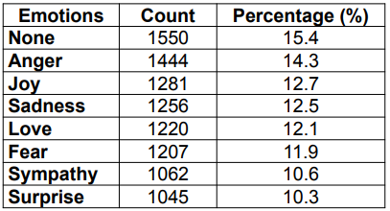
Our Contribution
We used the dataset (Nile University ) to verify our work.
The dataset collected by a research group at Nile University (NU).
It consisted of 10,065 tweets, and was annotated using 8 emotions.
The dataset consists mostly of Egyptian tweets.
It was collected using the ”Olympics” hashtags

Slide 12
Our Contribution
Grouped the emoji's and emoticons in a dictionary and mapped them in the tweets to equivalent Arabic emotions.
Performed 2 sets of experiments: one using the preprocessing techniques to reduce words to its root , another by adding a new step to replace emoji's and emoticons with their meaning

Slide 13
Our Contribution
For example
الاوليمبياد دي لذيذه اوووي 😍😍/ The Olympics is so nice 😍😍
الاوليمبياد دي لذيذه اوووي حب حب / The Olympics is so nice love love
ما هذا الالم 💔 / what is this pain 💔
ما هذا الالم حزن / what is the pain sadness
We implemented TF-IDF model and tried with the preprocessing techniques and compared the results with previous work

Slide 14

Our Contribution
Built classical machine learning classifiers:
SVM
Naive Bayes
Complement Naive Bayes
Logistic Regression
Decision Tree
Built the weighted voting ensemble model by assigning greater weights to the best classifiers (LR ,SVM ,Complement NB)

Slide 15

we will compare between two technique of stemmers to see which one will effect more in accuracy of classifiers first : SnowballStemmer second : ISRIStemmer

Slide 16
After testing the two stemmers: effect on accuracy of classifier
Classifier | ISRIStemmer | SnowballStemmer
Multinomial naive Bayes | 59 % | 60 %
complement model naive Bayes | 61 % | 63 %
Support vector machine (SVM) | 64 % | 66 %
Logistic regression (LR) | 64 % | 65 %
Ensemble model | 65 % | 66 %
Decision tree (DT) | 52 % | 56 %
We conclude that snowballstemmer give more accuracy in each classifier

Slide 17
presentation of the results
Classifiers | TF-IDF
 | 2021 | 2022
Logistic regression (LR) | 68 % | 66 %
Support vector machine (SVM) | 68 % | 67 %
Multinomial naïve Bayes | 61 % | 60 %
Complement naïve Bayes | 64 % | 63 %
Decision tree (DT) | 54 % | 56 %
ENSEMBLE (LR,SVM, CNB) |  | 67 %

Slide 18
RESULTS WITH EXPERIMENTS
CLASSIFIERS | With emoji, with stemming | Without emoji ,with stemming | With emoji ,without stemming | Without emoji ,without stemming | Replacing emoji ,With stemming | Replacing emoji ,without stemming
Logistic regression (LR) | 65 % | 66 % | 64 % | 64 % | 66 % | 64 %
Support vector machine (SVM) | 65 % | 67 % | 64 % | 65 % | 67 % | 66 %
Multinomial naïve Bayes | 60 % | 60 % | 59 % | 59 % | 60 % | 59 %
Complement naïve Bayes | 62 % | 63 % | 62 % | 62 % | 63 % | 62 %
Decision tree (DT) | 56 % | 55 % | 53 % | 52 % | 56 % | 54 %
ENSEMBLE (LR,SVM, CNB) | 66 % | 67 % | 64 % | 64 % | 67 % | 65 %

Slide 19
So from previous table we can conclude that experiment that we replace emoji with text of its meaning and use stemming get the best accuracy of experiments
Its just small difference between experiments accuracy
We can notice also that ensemble model gets best accuracy across classifiers and decision tree is weaker one

Slide 20

Now we use LIME is to explain a prediction of a complex model by fitting a local surrogate model whose predictions are easy to explain. This method explains any black box model by creating local approximation using a simple local model.

Slide 21
Lime results for one tweet
 | With emoji with stemming | Without emoji With stemming | With emoji without stemming | Without emoji without stemming | Replacing emoji with stemming | Replacing emoji without stemming
Complement NV | 27 | 23 | 30 | 26 | 26 | 33
Multinomial NB | 27 | 49 | 30 | 41 | 63 | 64
SVM | 100 | 99 | 100 | 99 | 99 | 100
LG | 92 | 91 | 85 | 76 | 95 | 92
DT | 100 misclassification | 100 | 100 | 100 | 100 | 100
Ensemble(LG,NB,SVM) | 97 | 96 | 95 | 93 | 97 | 97

Slide 22
Conclusion
We conclude that the best preprocessing technique is to replace emoji with text and do stemming at the same time
We were expect that the ensemble model will has the best explanation as it has high accuracy in more than one split of the dataset
We found that svm has high accuracy with lime and represent 100% for one tweet so it need further tries for another tweets to show that if it will work will or not

